Slide 1

Chapter 2. Getting to Know Your Data
Meng Jiang
CS412 Summer 2017:
Introduction to Data Mining

Slide 2
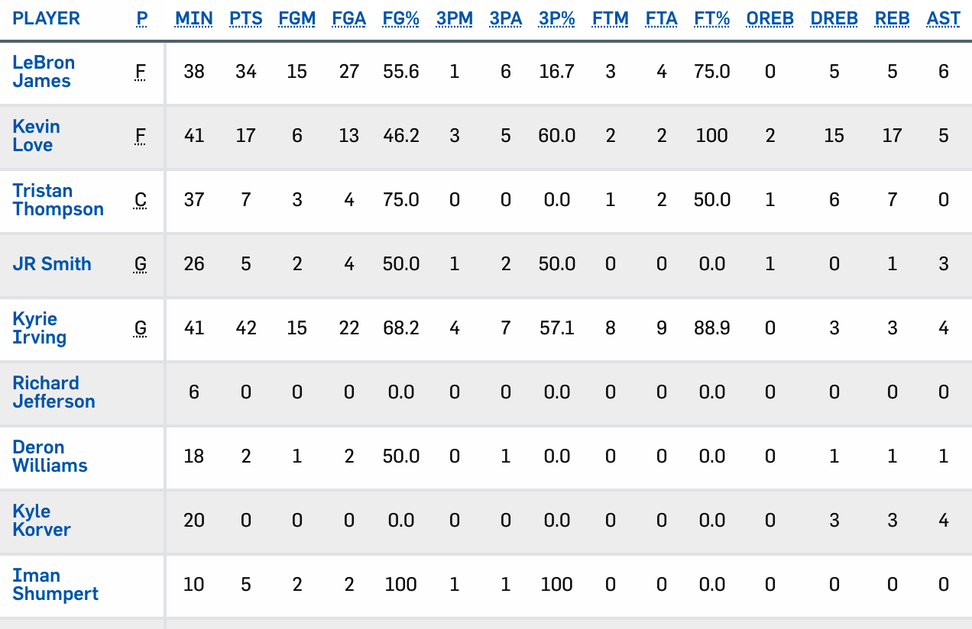
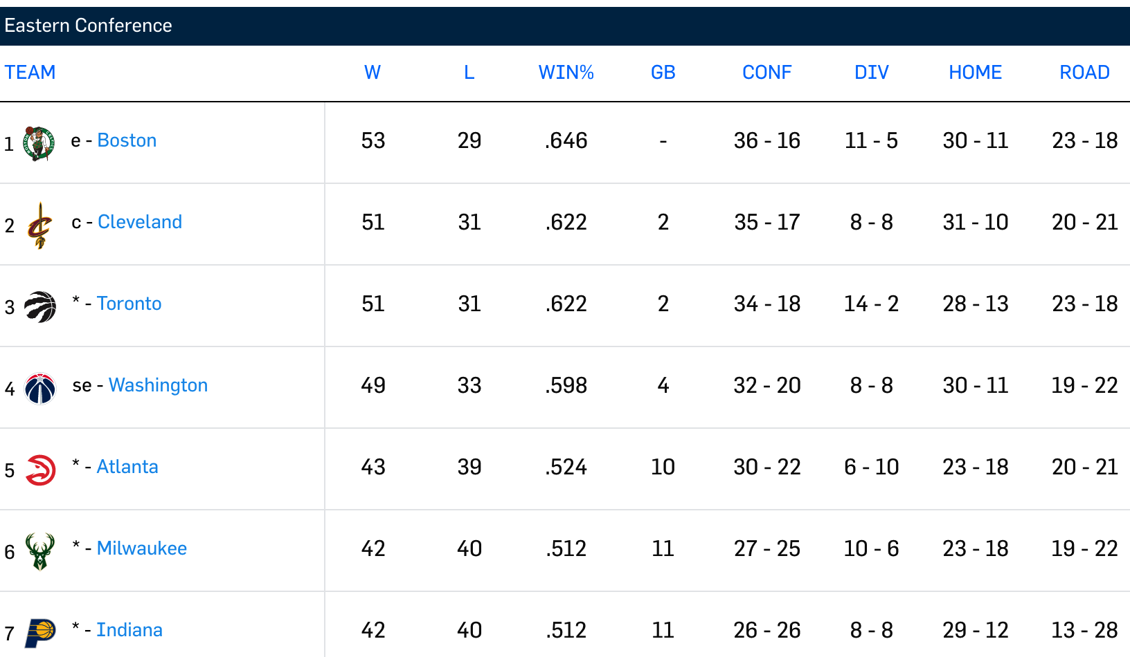
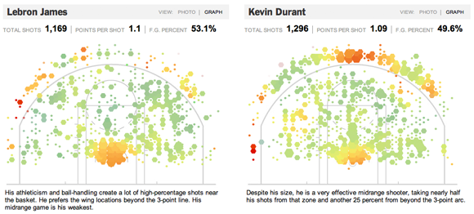
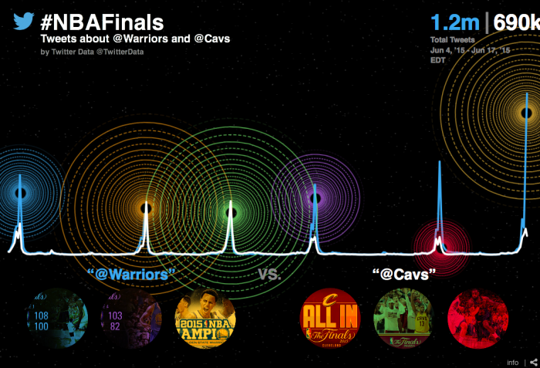
From Data to Knowledge

Slide 3
Your Data
 | Number
Students who provide us data | ?
Count of words in total | ?
Average count of words per student | ?
Count of non-stop-words in total | ?
Average count of non-stop-words per student | ?
Number of words (size of vocabulary) | ?
Number of non-stop-words | ?

Slide 4
Your Data
 | Number
Students who provide us data | ?
Count of words in total | 1,175
Average count of words per student | ?
Count of non-stop-words in total | ?
Average count of non-stop-words per student | ?
Number of words (size of vocabulary) | ?
Number of non-stop-words | ?

Slide 5
Your Data
 | Number
Students who provide us data | 29
Count of words in total | 1,175
Average count of words per student | 40.5
Count of non-stop-words in total | 494
Average count of non-stop-words per student | 17.0
Number of words (size of vocabulary) | 426
Number of non-stop-words | 298

Slide 6
Your Data
Word | Count
i | 74
to | 45
a | 43
in | 39
and | 38
am | 32
the | 29
of | 26
data | 23
my | 15
this | 14
Word | #Students
i | 27
a | 25
to | 22
am | 22
in | 20
and | 19
the | 18
data | 15
of | 13
this | 11
my | 11

Slide 7
Your Data
Word | Count
data | 23
student | 10
major | 9
engineering | 9
class | 8
mining | 7
students | 7
science | 6
grad | 6
learning | 6
interested | 6
Word | #Students
data | 15
student | 9
major | 8
engineering | 8
class | 7
mining | 6
science | 5
learning | 5
graduate | 5
interested | 5
students | 5

Slide 8
Knowledge (Patterns) You Want
Students’ personal interests (activities) and connect them with like-minded individuals * 2
Correlation between classes students have taken and their grades
Correlation between nationalities and interests in data mining
Correlation between handwriting patterns and academic performance
Classify students by their background knowledge of data mining
Clustering students by their interests or backgrounds
…

Slide 9
Knowledge (Patterns) You Want
Students’ personal interests (activities) and connect them with like-minded individuals * 2
Correlation between classes students have taken and their grades
Correlation between nationalities and interests in data mining
Correlation between handwriting patterns and academic performance
Classify students by their background knowledge of data mining
Clustering students by their interests or backgrounds
…
During the 5-minute break (11:40-11:45),
if you’d like to contribute,
please grab a paper and
write down your self-introduction and give it to me at the end of class.
Pay attention to privacy issue!

Slide 10
Knowledge/Patterns We Can Have: Phrase Structures
Phrase | Score
civil engineering | 0.94
machine learning | 0.93
big data | 0.93
classify group | 0.84
master student | 0.82
cs knowledge | 0.81
students’ academic performance matches | 0.81
human body | 0.81
favoriate colors | 0.80
skill levels | 0.80
algorithm design | 0.80
Phrase | Score
masters in computer science | 0.70
academic history and transcripts | 0.70
sophomore majored in statistics | 0.70
professor of music history | 0.70
addition to computer science | 0.70
control modeling and management | 0.69
Phrase | Score
4th year phd candidate | 0.68
soccer and practice guitar | 0.67
Phrase | Score
a computer | 0.08
the data | 0.08
and major | 0.08

Slide 11
Knowledge/Patterns We Can Have: Phrase Structures
Phrase | Score
civil engineering | 0.94
machine learning | 0.93
big data | 0.93
classify group | 0.84
master student | 0.82
cs knowledge | 0.81
students’ academic performance matches | 0.81
human body | 0.81
favoriate colors | 0.80
skill levels | 0.80
algorithm design | 0.80
Phrase | Score
masters in computer science | 0.70
academic history and transcripts | 0.70
sophomore majored in statistics | 0.70
professor of music history | 0.70
addition to computer science | 0.70
control modeling and management | 0.69
Jingbo Shang, Jialu Liu, Meng Jiang, Xiang Ren, and Jiawei Han,
“Automated Phrase Mining from Massive Text Corpora”.
arXiv: 1702:04457
Phrase | Score
4th year phd candidate | 0.68
soccer and practice guitar | 0.67
Phrase | Score
a computer | 0.08
the data | 0.08
and major | 0.08

Slide 12
Chapter 2. Getting to Know Your Data
Data Objects and Attribute Types
Basic Statistical Descriptions
Data Visualization
Measuring Data Similarity and Dissimilarity

Slide 13
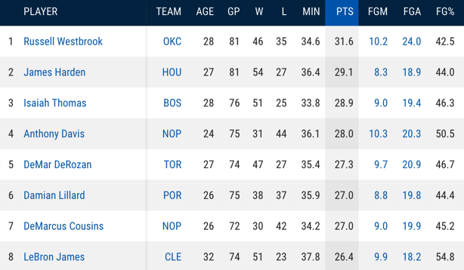
Types of Data Sets: (1) Record Data
Relational records in relational tables: highly structured
Data matrix: numerical matrix
Transaction data
Document data: Term-frequency matrix of text documents
Notes:
Data objects, attribute types

Slide 14
Data Objects
Data sets are made up of data objects.
A data object represents an entity.
Examples:
Sales database: customers, store items, sales.
Medical database: patients, treatments.
University database: students, professors, courses.
Also called samples, examples, instances, data points, objects, tuples.
Data objects are described by attributes.
Database rows → data objects; columns → attributes.

Slide 15
Attributes
Attribute (or dimensions, features, variables)
A data field, representing a characteristic or feature of a data object
Types:
Nominal (e.g., red, blue)
Binary (e.g., {true, false})
Ordinal (e.g., {freshman, sophomore, junior, senior})
Numeric: quantitative
Interval-scaled: 100○C is interval scales
Ratio-scaled: 100○K is ratio scaled since it is twice as high as 50 ○K

Slide 16
Attribute Types
Nominal: categories, states, or “names of things”
Hair_color = {auburn, black, blond, brown, grey, red, white}
marital status, occupation, ID numbers, zip codes
Binary
Nominal attribute with only 2 states (0 and 1)
Symmetric binary: both outcomes equally important
e.g., gender
Asymmetric binary: outcomes not equally important.
e.g., medical test (positive vs. negative)
Convention: assign 1 to most important outcome (e.g., HIV positive)
Ordinal
Values have a meaningful order (ranking) but magnitude between successive values is not known
Size = {small, medium, large}, grades, army rankings

Slide 17
Discrete vs Continuous Attributes
Discrete Attribute
Has only a finite or countable infinite set of values
E.g., zip codes, profession, or the set of words in a collection of documents
Sometimes, represented as integer variables
Note: Binary attributes are a special case of discrete attributes
Continuous Attribute
Has real numbers as attribute values
E.g., temperature, height, or weight
Practically, real values can only be measured and represented using a finite number of digits
Continuous attributes are typically represented as floating-point variables

Slide 18
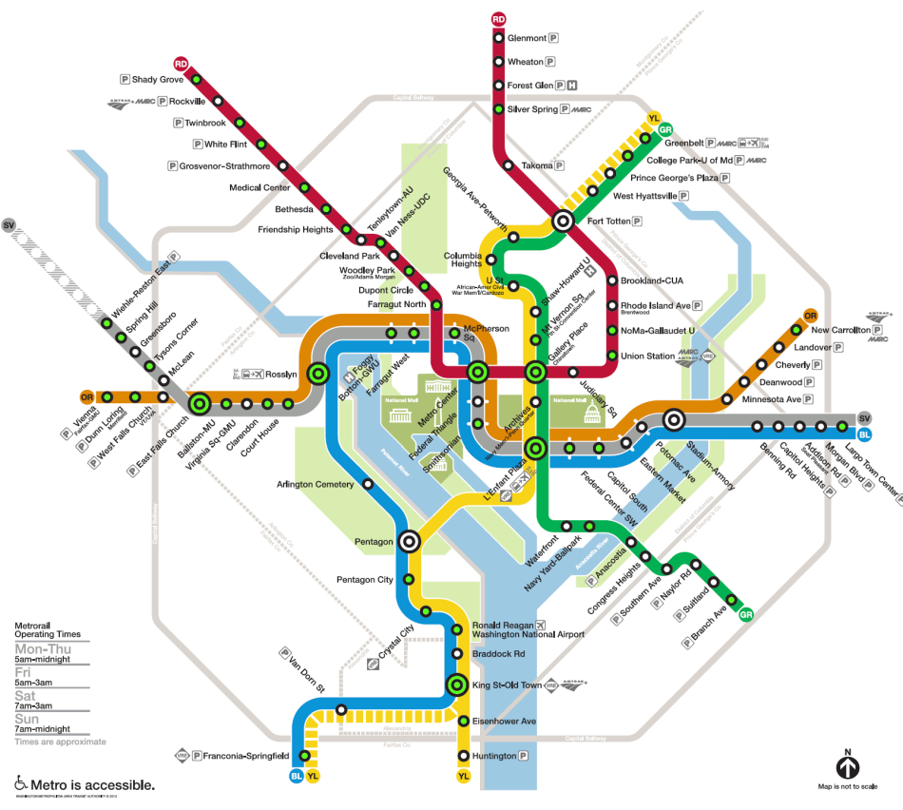
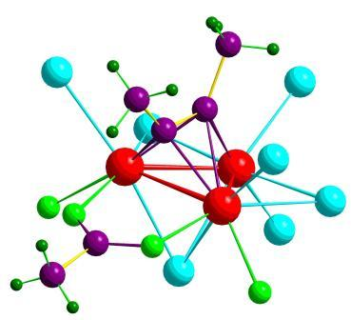

Types of Data Sets: (2) Graphs and Networks
Transportation networks
World Wide Web
Molecular structures
Social or information networks
Notes:
Data objects, attribute types

Slide 19
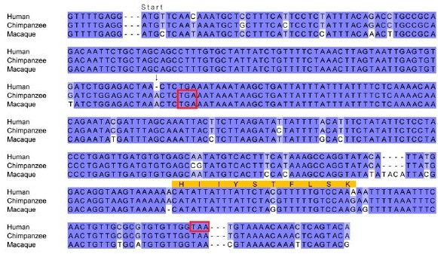
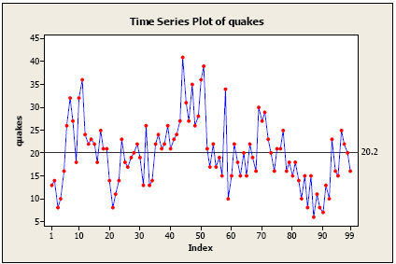
Types of Data Sets: (3) Ordered Data
Video data: sequence of images
Temporal data: time-series
Sequential Data: transaction sequences
Genetic sequence data
Notes:
Data objects, attribute types

Slide 20
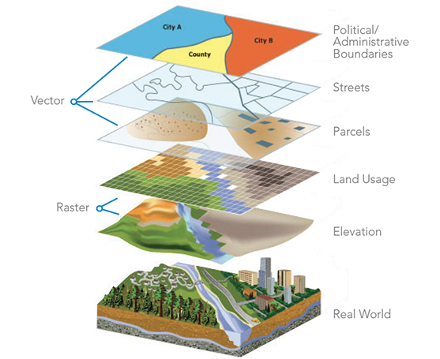

Other Types of Data Sets
Spatial data
Image and multimedia data
Notes:
Patterns, knowledge, data objects, attribute types

Slide 21
Characterisitcs of Structured Data
Dimensionality
Curse of dimensionality
Sparsity
Only presence counts
Resolution
Patterns depend on the scale
Distribution
Centrality and dispersion

Slide 22
Chapter 2. Getting to Know Your Data
Data Objects and Attribute Types
Basic Statistical Descriptions
Data Visualization
Measuring Data Similarity and Dissimilarity

Slide 23
Basic Statistical Descriptions of Data
Motivation: to better understand the data
Data dispersion characteristics
Median, max, min, quantiles, outliers, variance, ...
Numerical dimensions correspond to sorted intervals
Data dispersion:
Analyzed with multiple granularities of precision
Boxplot or quantile analysis on sorted intervals
Dispersion analysis on computed measures
Folding measures into numerical dimensions
Boxplot or quantile analysis on the transformed cube

Slide 24
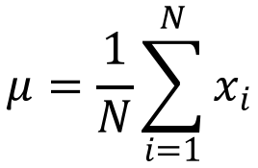
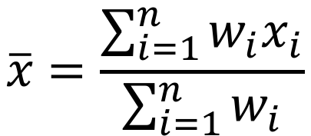
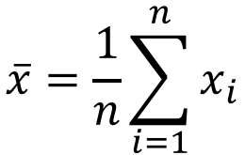
Measuring the Central Tendency: (1) Mean
Mean (algebraic measure) (sample vs. population):
Note: n is sample size and N is population size.
Weighted arithmetic mean:
Trimmed mean: Chopping extreme values (e.g., Olympics gymnastics score computation)
$$\overline{x}=\frac{1}{n}\sum_{i=1}^{n}{x_{i}}$$
$$μ=\frac{1}{N}\sum_{i=1}^{N}{x_{i}}$$
$$\overline{x}=\frac{\sum_{i=1}^{n}{{w_{i}x}_{i}}}{\sum_{i=1}^{n}{w_{i}}}$$

Slide 25
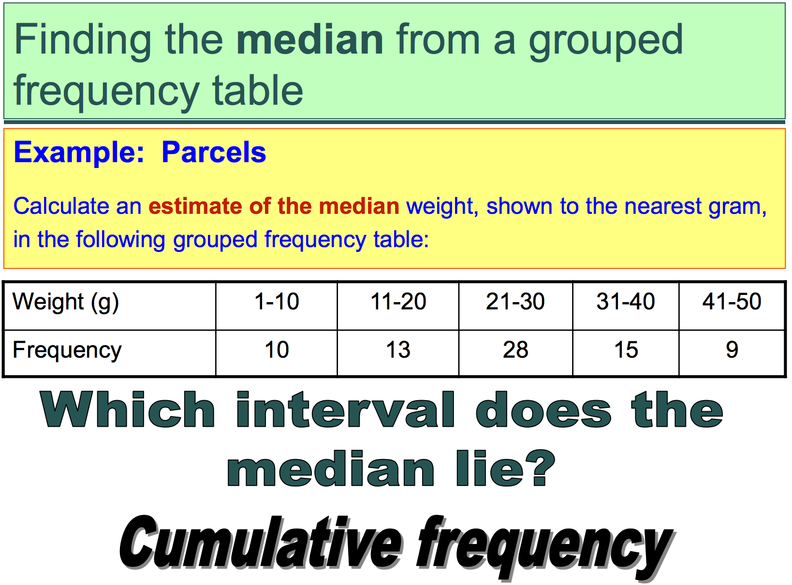
Measuring the Central Tendency: (2) Median
Median:
Middle value if odd number of values, or average of the middle two values otherwise
Estimated by interpolation (for grouped data):

Slide 26
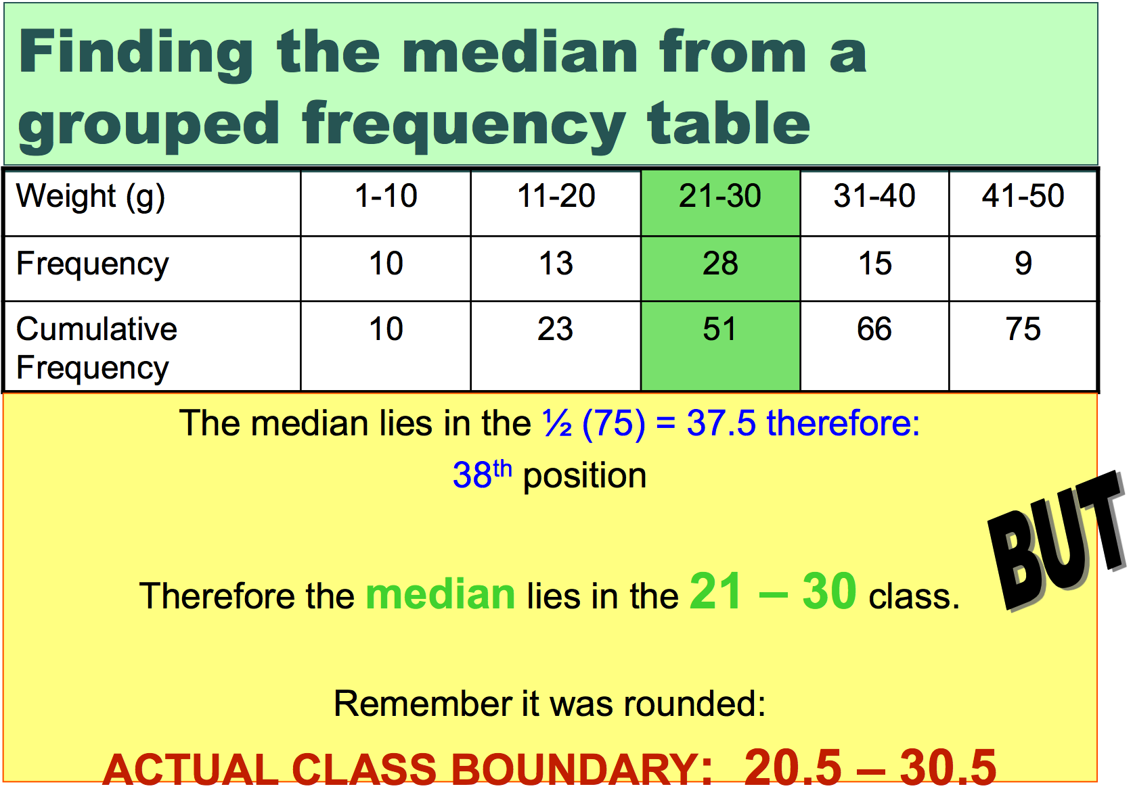

Slide 27
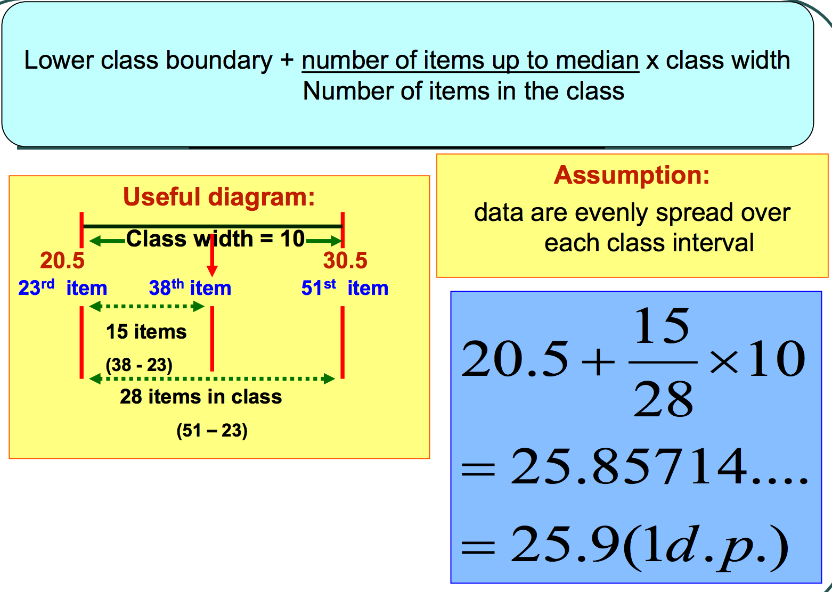

Slide 28
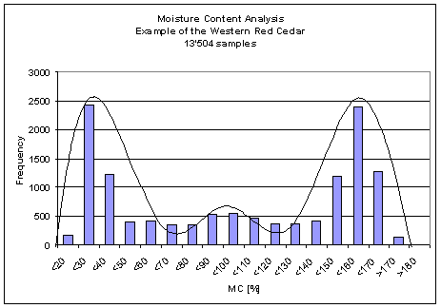
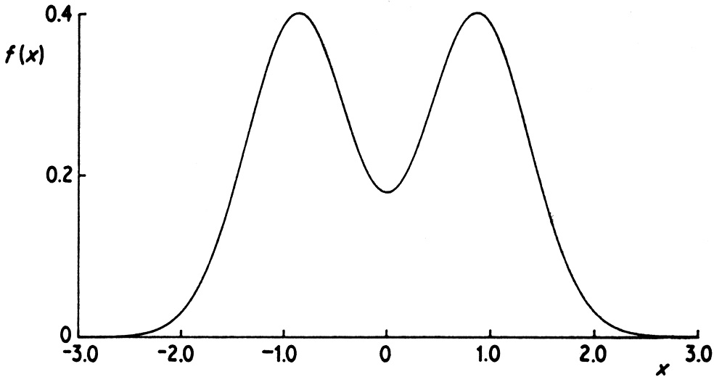
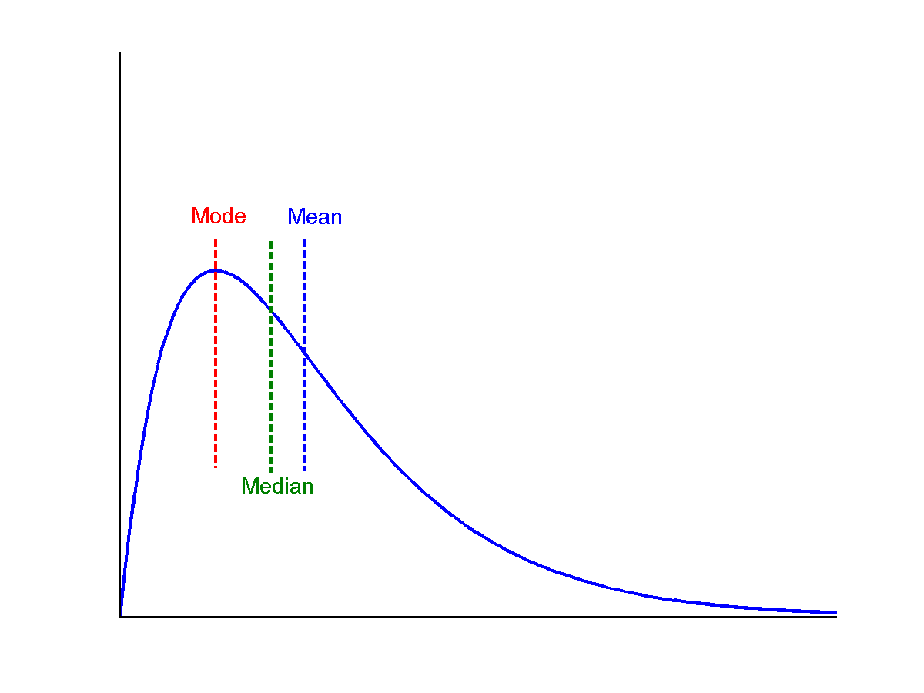
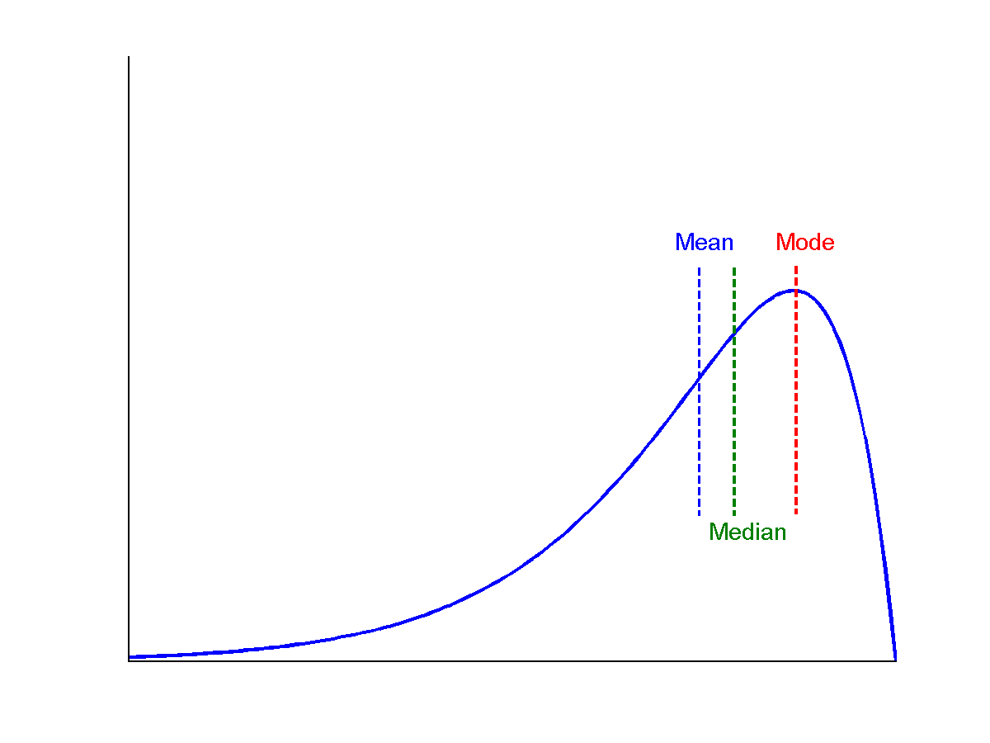
Measuring the Central Tendency: (3) Mode
Mode: Value that occurs most frequently in the data
Multi-modal
Bimodal
Trimodal
Symmetric data
Positively skewed data
Negatively skewed data

Slide 29
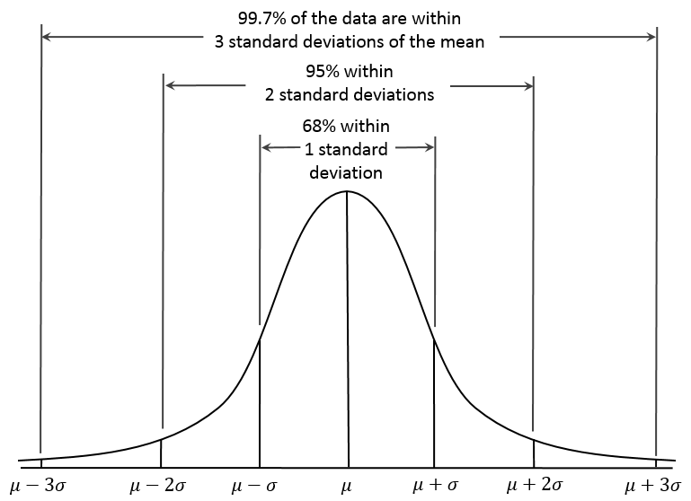
Properties of Normal Distribution Curve
Z-score -3 -2 -1 0 1 2 3

Slide 30
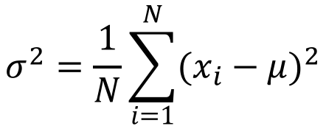
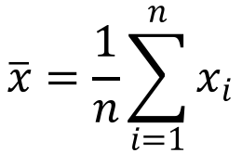
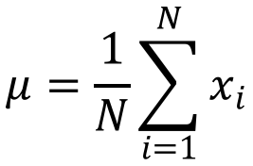
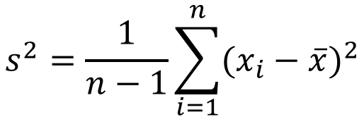
Measures Data Distribution: Variance and Standard Deviation
Variance and standard deviation (sample: s, population: σ)
Variance: (algebraic, scalable computation)
Q: Can you compute it incrementally and efficiently?
Standard deviation s (or σ) is the square root of variance s² (or σ²)
$$s^{2}=\frac{1}{n−1}\sum_{i=1}^{n}{{(x_{i}−\overline{x})}^{2}}$$
$$\overline{x}=\frac{1}{n}\sum_{i=1}^{n}{x_{i}}$$
$$σ^{2}=\frac{1}{N}\sum_{i=1}^{N}{{(x_{i}−μ)}^{2}}$$
$$μ=\frac{1}{N}\sum_{i=1}^{N}{x_{i}}$$

Slide 31
Graphic Displays of Basic Statistical Descriptions
Boxplot: graphic display of five-number summary
Histogram: x-axis are values, y-axis repres. frequencies
Quantile plot: each value x_{i} is paired with f_{i} indicating that approximately 100 f_{i} % of data are ≤ x_{i}
Quantile-quantile (q-q) plot: graphs the quantiles of one univariant distribution against the corresponding quantiles of another
Scatter plot: each pair of values is a pair of coordinates and plotted as points in the plane

Slide 32
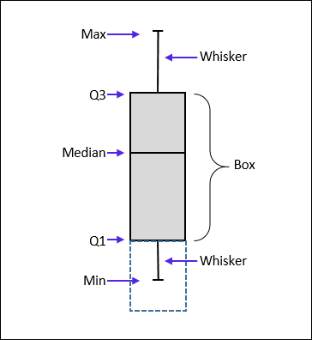
Measuring the Dispersion of Data: (1) Quartiles & Boxplots
Quartiles: Q₁ (25th percentile), Q₃ (75th percentile)
Inter-quartile range: IQR = Q₃ – Q₁
Five number summary: min, Q₁, median, Q₃, max
Boxplot: Data is represented with a box
Q₁, Q₃, IQR: The ends of the box are at the first and third quartiles, i.e., the height of the box is IQR
Median (Q₂) is marked by a line within the box
Whiskers: two lines outside the box extended to Minimum and Maximum
Outliers: points beyond a specified outlier threshold, plotted individually
Outlier: usually, a value higher/lower than 1.5 x IQR

Slide 33
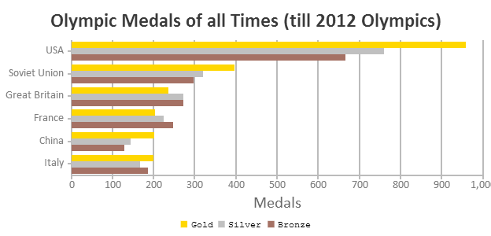
(2) Histogram Analysis
Histogram: Graph display of tabulated frequencies, shown as bars
Between histograms and bar charts
Histograms are used to show distributions of variables while bar charts are used to compare variables
Histograms plot binned quantitative data while bar charts plot categorical data
Bars can be reordered in bar charts but not in histograms
Differs from a bar chart in that it is the area of the bar that denotes the value, not the height as in bar charts, a crucial distinction when the categories are not of uniform width

Slide 34
Histograms Often Tell More than Boxplots
The two histograms may have the same boxplot
The same values for: min, Q1, median, Q3, max
But they have rather different data distributions

Slide 35
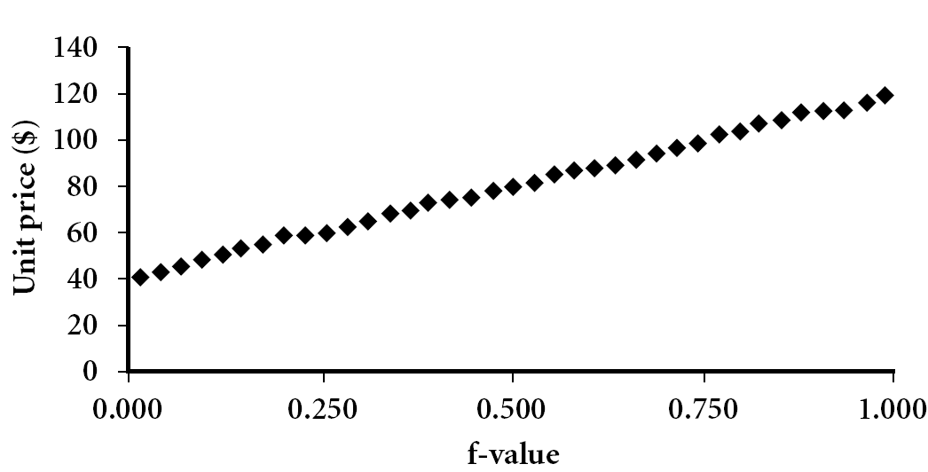
(3) Quantile Plot
Displays all of the data (allowing the user to assess both the overall behavior and unusual occurrences)
Plots quantile information
For a data x_{i} data sorted in increasing order, f_{i} indicates that approximately 100 f_{i}% of the data are below or equal to the value x_{i}

Slide 36
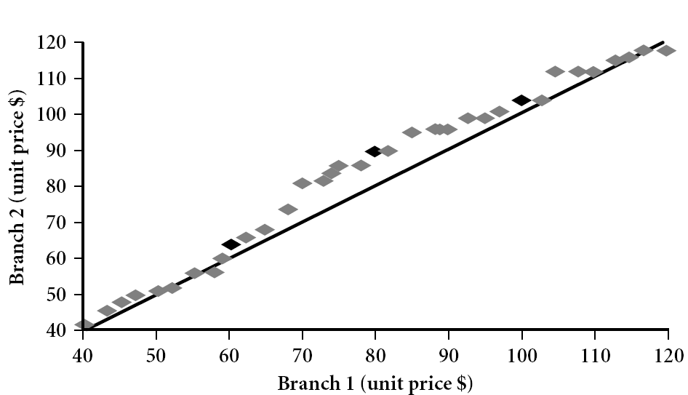
(4) Quantile-Quantile (Q-Q) Plot
Graphs the quantiles of one univariate distribution against the corresponding quantiles of another
View: Is there is a shift in going from one distribution to another?
Example shows unit price of items sold at Branch 1 vs. Branch 2 for each quantile. Unit prices of items sold at Branch 1 tend to be lower than those at Branch 2
Notes:
We label the dark plotted points as Q1, Median, Q3. There is a shift in distribution of branch 1 WRT branch 2 in that the unit prices of items sold at branch 1 tend to be lower than those at branch 2.

Slide 37
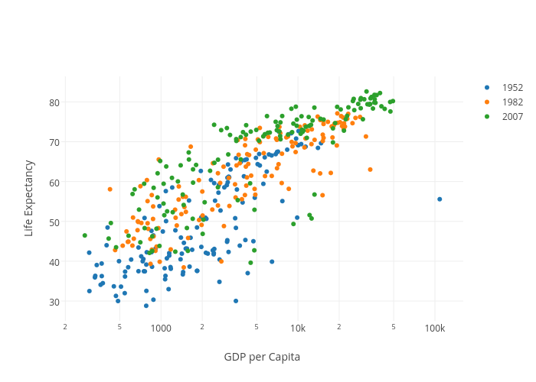
(5) Scatter plot
Provides a first look at bivariate data to see clusters of points, outliers, etc.
Each pair of values is treated as a pair of coordinates and plotted as points in the plane

Slide 38
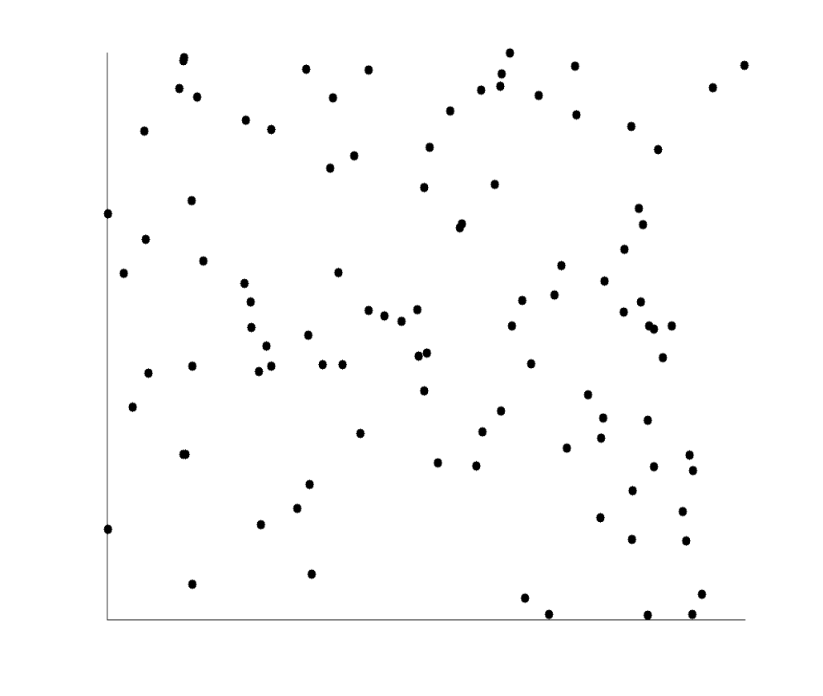
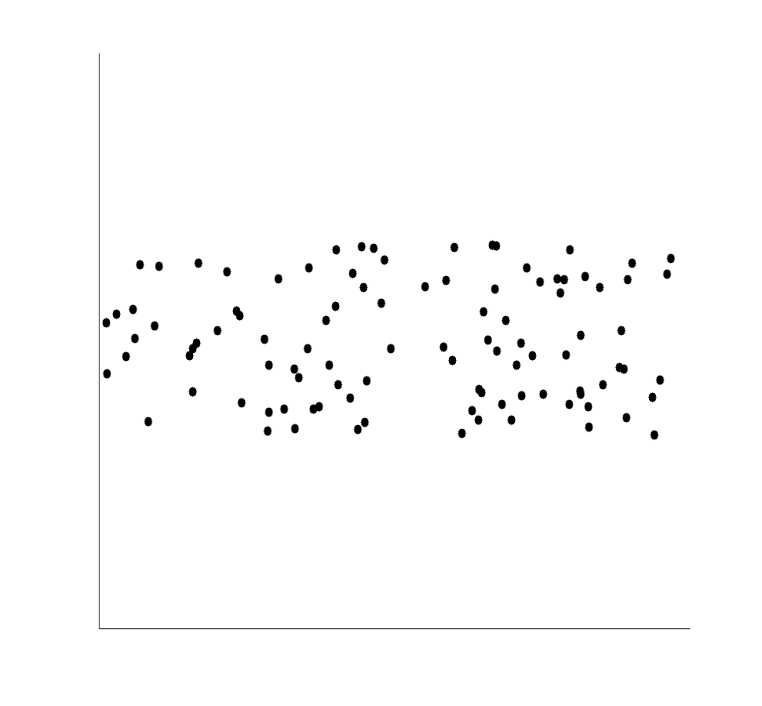
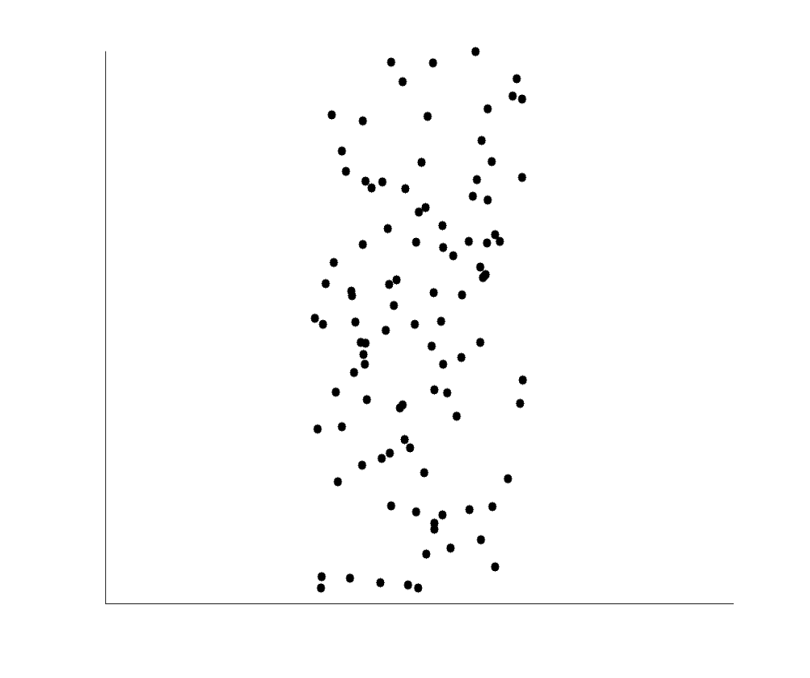
Positively, Negatively Correlated, and Uncorrelated Data

Slide 39
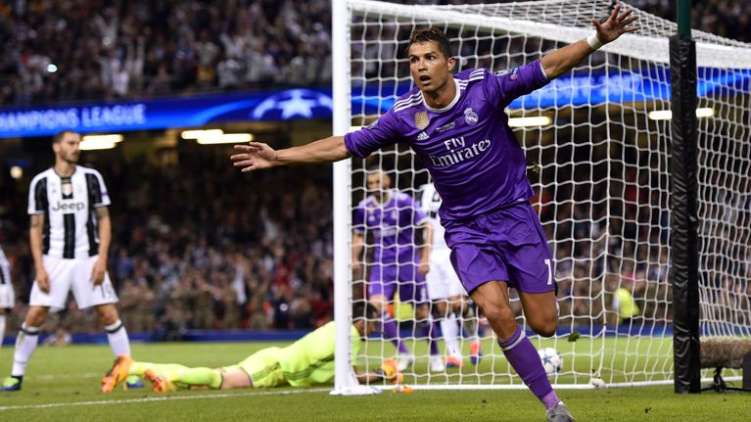
Chapter 2. Getting to Know Your Data
Meng Jiang
CS412 Summer 2017:
Introduction to Data Mining

Slide 40
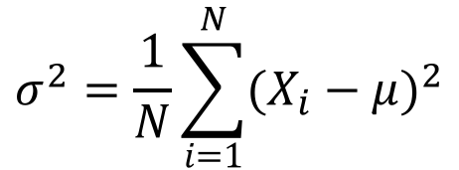
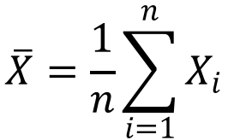
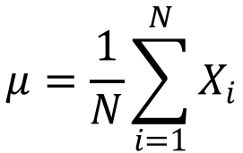
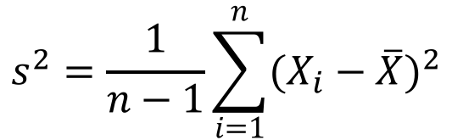
Review: Lecture 2
Data objects, attributes, and attribute types
Statistical descriptions
min, Q1, median, Q3, max; mean, variance, standard deviation; mode
sample (s) vs population (σ)
$$s^{2}=\frac{1}{n−1}\sum_{i=1}^{n}{{(X_{i}−\overline{X})}^{2}}$$
$$\overline{X}=\frac{1}{n}\sum_{i=1}^{n}{X_{i}}$$
Why?
$$σ^{2}=\frac{1}{N}\sum_{i=1}^{N}{{(X_{i}−μ)}^{2}}$$
$$μ=\frac{1}{N}\sum_{i=1}^{N}{X_{i}}$$

Slide 41
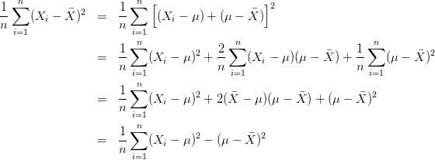
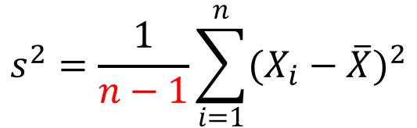
Biased Sample Variance
Biased
Unbiased
$$s^{2}=\frac{1}{n−1}\sum_{i=1}^{n}{{(X_{i}−\overline{X})}^{2}}$$
Bessel’s Correction: 3 alternative proofs of correctness

Slide 42
Z-score in Normal Distribution
Z-score: The distance between the raw score and the population mean in the unit of the standard deviation
Z-score -3 -2 -1 0 1 2 3

Slide 43
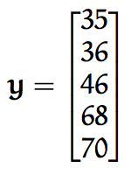
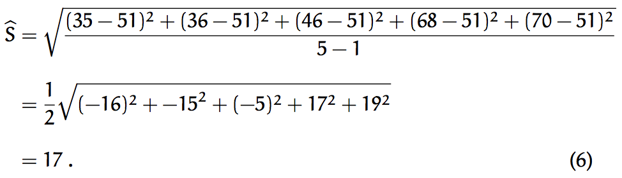
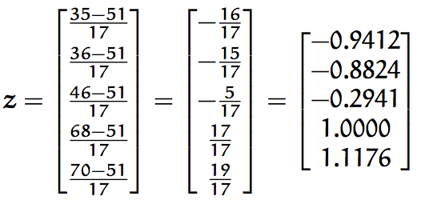
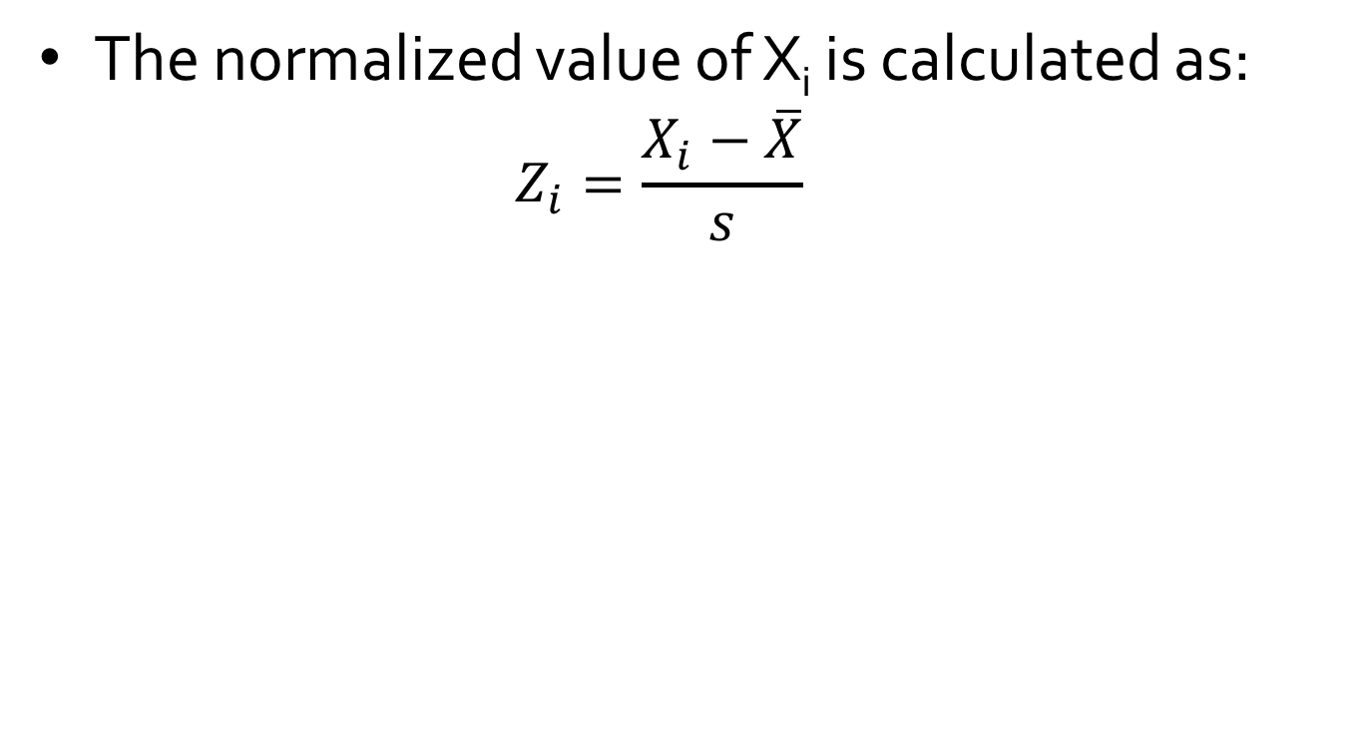
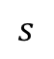
Z-score Normalization
The normalized value of X_{i} is calculated as:
$$Z_{i}=\frac{X_{i}−\overline{X}}{s}$$
$$s$$

Slide 44
Review: Lecture 2
Q-Q plot

Slide 45
Review: Scatter Plot

Slide 46
Chapter 2. Getting to Know Your Data
Data Objects and Attribute Types
Basic Statistical Descriptions
Data Visualization
Measuring Data Similarity and Dissimilarity

Slide 47
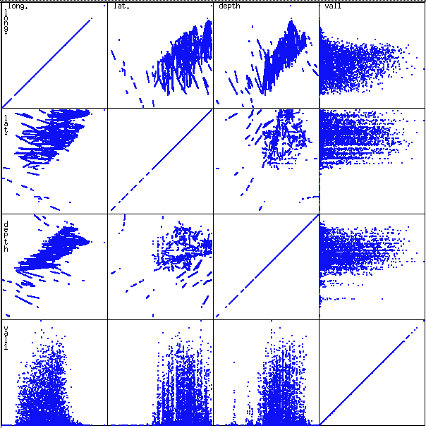
Scatterplot Matrices

Slide 48
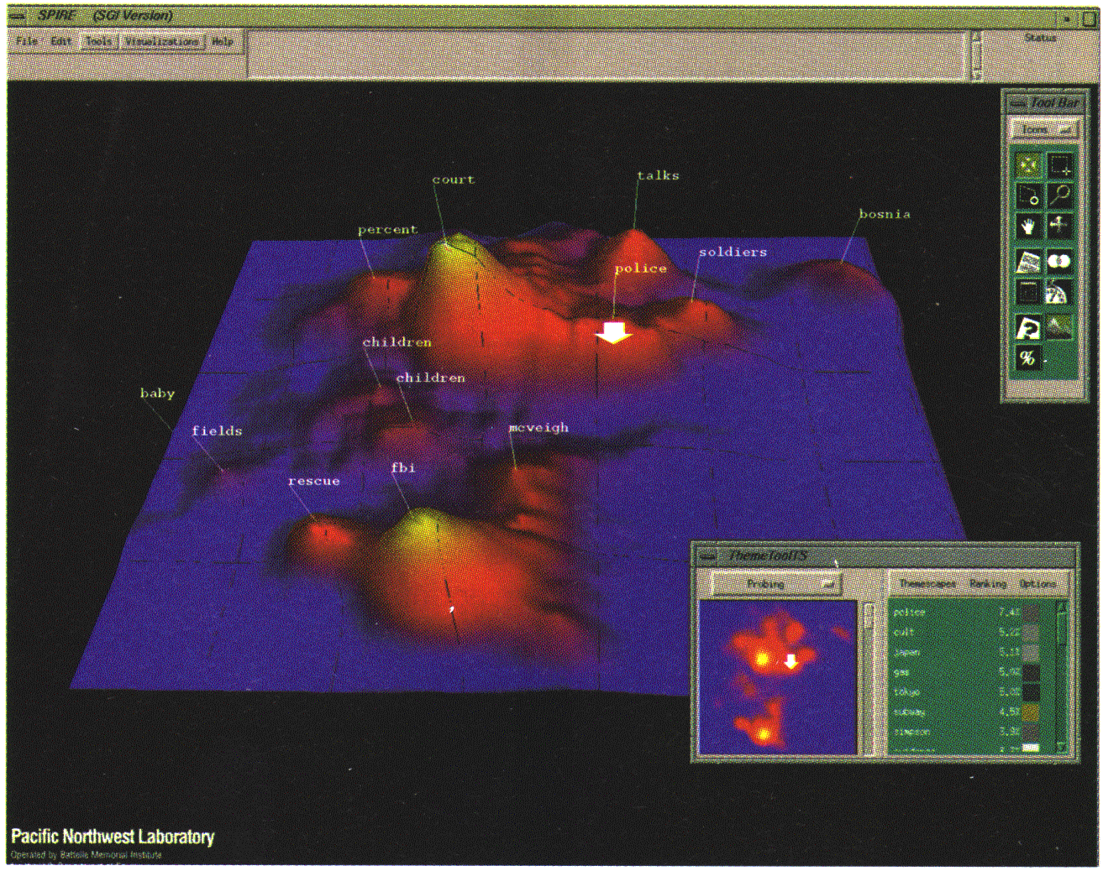
Landscapes
news articles visualized as a landscape

Slide 49
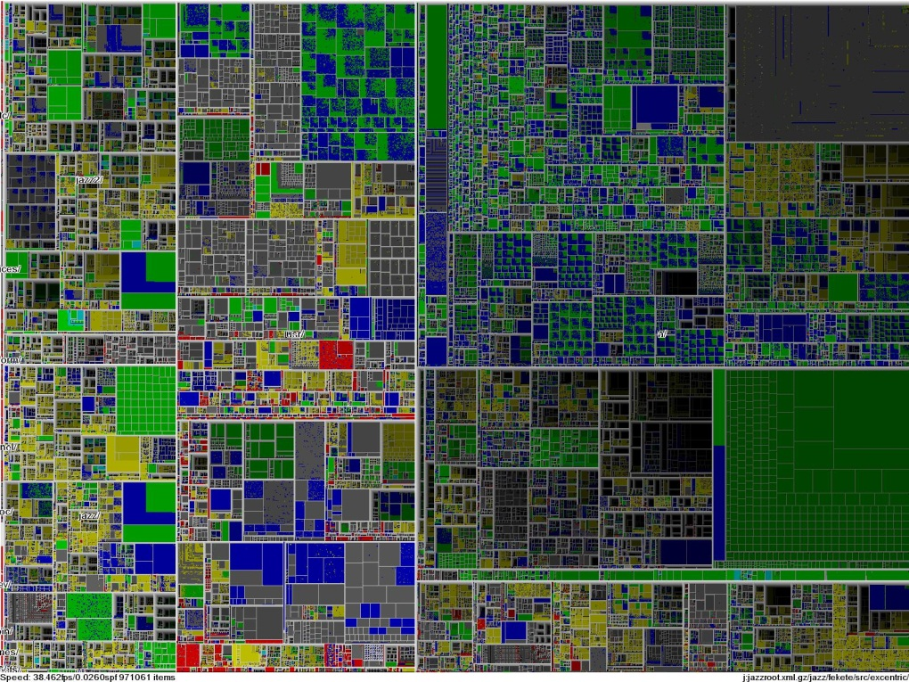
Tree-Map
Screen-filling method which uses a hierarchical partitioning of the screen into regions depending on the attribute values
The x- and y-dimension of the screen are partitioned alternately according to the attribute values (classes)

Slide 50

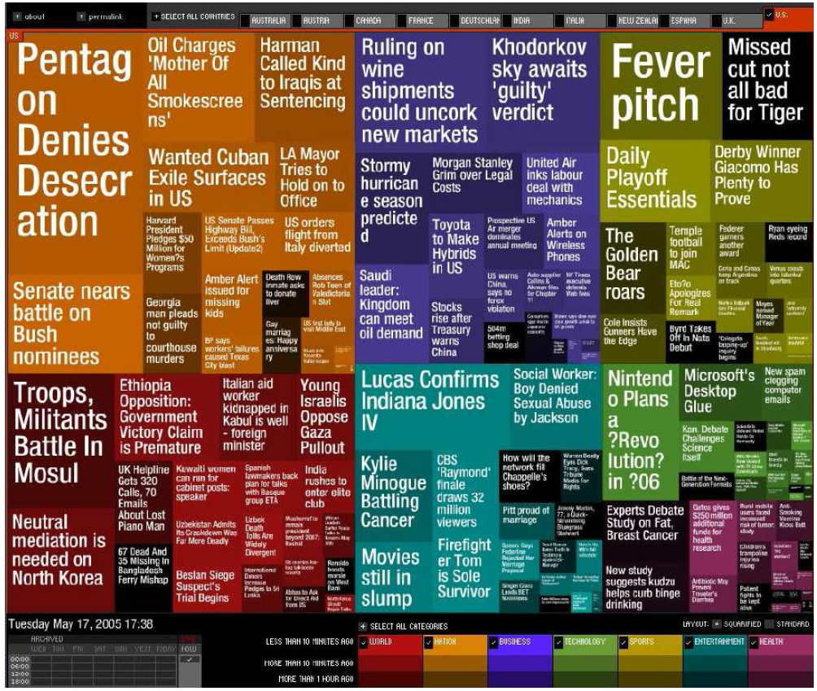
Tag Cloud
KDD 2013 Research Paper Title
Newsmap: Google News Stories in 2005

Slide 51
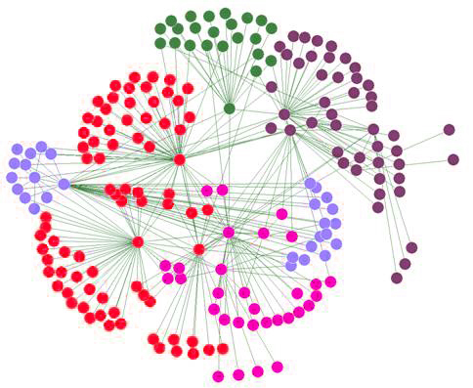



Networks
A typical network structure
organizing information networks
A social network

Slide 52
Chapter 2. Getting to Know Your Data
Data Objects and Attribute Types
Basic Statistical Descriptions
Data Visualization
Measuring Data Similarity and Dissimilarity

Slide 53
Similarity, Dissimilarity, and Proximity
Similarity measure or similarity function
A real-valued function that quantifies the similarity between two objects
Measure how two data objects are alike: The higher value, the more alike
Often falls in the range [0,1]: 0: no similarity; 1: completely similar
Dissimilarity (or distance) measure
Numerical measure of how different two data objects are
In some sense, the inverse of similarity: The lower, the more alike
Minimum dissimilarity is often 0 (i.e., completely similar)
Range [0, 1] or [0, ∞) , depending on the definition
Proximity usually refers to either similarity or dissimilarity

Slide 54
Data Matrix and Dissimilarity Matrix
Data matrix
A data matrix of n data points with l dimensions
Dissimilarity (distance) matrix
n data points, but registers only the distance d(i, j)
Usually symmetric, thus a triangular matrix
Distance functions are usually different for real, boolean, categorical, ordinal, ratio, and vector variables
Weights can be associated with different variables based on applications and data semantics
…
…

Slide 55
Example: Euclidean Distance
Data Matrix
Dissimilarity Matrix (by Euclidean Distance)

Slide 56
Minkowski Distance
Minkowski distance: A popular distance measure
where i = (x_{i1}, x_{i2}, …, x_{il}) and j = (x_{j1}, x_{j2}, …, x_{jl}) are two l-dimensional data objects, and p is the order (the distance so defined is called L-p norm)
Properties
d(i, j) > 0 if i ≠ j, and d(i, i) = 0 (Positivity)
d(i, j) = d(j, i) (Symmetry)
d(i, j) ≤ d(i, k) + d(k, j) (Triangle Inequality)
A distance that satisfies these properties is a metric
Note: There are nonmetric dissimilarities, e.g., set difference
…
or L-h norm

Slide 57

Non Metric Dissimilarity: Triangle Inequality

Slide 58
Special Cases of Minkowski Distance
p = 1: (L₁ norm) Manhattan (or city block) distance
E.g., the Hamming distance: the number of bits that are different between two binary vectors
p = 2: (L₂ norm) Euclidean distance
p → ∞: (L_{max} norm, L∞ norm) “supremum” distance
The maximum difference between any component (attribute) of the vectors
…
…
…

Slide 59
Example: Minkowski Distance at Special Cases
Manhattan (L₁)
Euclidean (L₂)
Supremum (L∞)

Slide 60




Proximity Measure for Binary Attributes
A contingency table for binary data
Distance measure for symmetric binary variables:
Distance measure for asymmetric binary variables:
Jaccard coefficient (similarity measure for asymmetric binary variables):
Note: Jaccard coefficient is the same as “coherence”:
Object j
Object i
Notes:
Jaccard coefficient: Facebook mutual friends of two users.

Slide 61
Proximity Measure for Categorical Attributes
Categorical data, also called nominal attributes
Example: Color (red, yellow, blue, green), profession, etc.
Method 1: Simple matching
m: # of matches, p: total # of variables
Method 2: Use a large number of binary attributes
Creating a new binary attribute for each of the M nominal states

Slide 62
Ordinal Variables
An ordinal variable can be discrete or continuous
Order is important, e.g., rank (e.g., freshman, sophomore, junior, senior)
Can be treated like interval-scaled
Replace an ordinal variable value by its rank and map the range of each variable onto [0, 1]:
Example: freshman: 0; sophomore: 1/3; junior: 2/3; senior 1
Then distance: d(freshman, senior) = 1, d(junior, senior) = 1/3
Compute the dissimilarity using methods for interval-scaled variables

Slide 63
Attributes of Mixed Types
A dataset may contain all attribute types
Nominal, symmetric binary, asymmetric binary, numeric, and ordinal
One may use a weighted formula to combine their effects:
If f is numeric: Use the normalized distance
If f is binary or nominal: d_{ij}^{(f)} = 0 if x_{if} = x_{jf}; or d_{ij}^{(f)} = 1 otherwise
If f is ordinal
Compute ranks z_{if} (where )
Treat z_{if} as interval-scaled

Slide 64

Cosine Similarity of Two Vectors
A document can be represented by a bag of terms or a long vector, with each attribute recording the frequency of a particular term (such as word, keyword, or phrase) in the document
Other vector objects: Gene features in micro-arrays
Applications: Information retrieval, biologic taxonomy, gene feature mapping, etc.
Cosine measure: If d₁ and d₂ are two vectors (e.g., term-frequency vectors), then
where • indicates vector dot product, ||d||: the length of vector d

Slide 65



KL Divergence: Comparing Two Probability Distributions
The Kullback-Leibler (KL) divergence: Measure the difference between two probability distributions over the same variable x
From information theory, closely related to relative entropy, information divergence, and information for discrimination
D_{KL}(p(x) || q(x)): divergence of q(x) from p(x), measuring the information lost when q(x) is used to approximate p(x)
Discrete form
Continuous form
Notes:
>= 0

Slide 66
Summary
Data attribute types: nominal, binary, ordinal, interval-scaled, ratio-scaled
Many types of data sets, e.g., numerical, text, graph, Web, image.
Gain insight into the data by:
Basic statistical data description: central tendency, dispersion, graphical displays
Data visualization: map data onto graphical primitives
Measure data similarity
Above steps are the beginning of data preprocessing
Many methods have been developed but still an active area of research

Slide 67
Announcement
Assignment 1 is out!
Due date: June 15th.
Compass
TAs: Xuan Wang (xwang174@illinois.edu) and Sheng Wang (swang141@illinois.edu)

Slide 68
4th Credit Project
Project goal:
Given a real dataset, (1) conduct data preprocessing and data cleaning, (2) define at least three data mining tasks, and (3) design and implement data mining methods: the project should go through the Knowledge Discovery in Databases (KDD) process.
Data sets:
KDD 2015-2016 papers: PDF files and TXT files.
224 KDD’15 papers and 206 KDD’16 papers.

Slide 69
Evaluation
Project organization: It contains all the steps of the KDD process: data preprocessing, data cube construction, data mining task definition, data mining method design, model evaluation, discussions and future work. (5%)
Data preprocessing and cube construction: How is the raw dataset transformed into an understandable format? How are the dimensions and values extracted from the dataset? Are basic data cube operations doable on the cube? (30%)
Task definition: Define at least three different data mining tasks (frequent pattern mining, classification, clustering, prediction, recommendation, outlier detection, etc.) with input and output as “Given … (concrete description of task-relevant data), find/classify/recommend/detect …”. (10% * 3 = 30%)
Data mining method design and model evaluation. (30%)
Discussions on how to use knowledge that has been discovered in real life and future work. (5%)

Slide 70


Slide 71
Tip 1: Dimension and Value Extraction
Paper | Dimension | Value | Paper | Dimension | Value
kdd15-p9 | PROBLEM | prediction | kdd15-p9 | DATASET | netflix
kdd15-p9 | METRIC | prediction accuracy | kdd15-p9 | DATASET | yahoo music
kdd15-p9 | PROBLEM | uncertainty | kdd15-p9 | PROBLEM | recommender systems
kdd15-p9 | PROBLEM | over-fitting | kdd15-p9 | PROBLEM | music recommendation
kdd15-p9 | METHOD | Bayesian matrix factorization | kdd15-p9 | PROBLEM | book recommendation
kdd15-p9 | PROBLEM | prohibitive cost of inference | kdd15-p9 | PROBLEM | movie recommendation
kdd15-p9 | METHOD | scalable distributed Bayesian matrix factorization | kdd15-p9 | PROBLEM | news recommendation
kdd15-p9 | METHOD | stochastic gradient mcmc | kdd15-p9 | PROBLEM | partner recommendation
kdd15-p9 | METHOD | distributed stochastic gradient langevin dynamics | kdd15-p9 | PROBLEM | recommender systems
kdd15-p9 | METHOD | mcmc | kdd15-p9 | DATASET | netflix
kdd15-p9 | METHOD | gibbs sampling | kdd15-p9 | PROBLEM | recommender
kdd15-p9 | METHOD | stochastic gradient descent | kdd15-p9 | DATASET | netflix movie rating
kdd15-p9 | PROBLEM | prediction | kdd15-p9 | METHOD | bayesian probabilistic matrix factorization
kdd15-p9 | METRIC | accuracy | kdd15-p9 | METHOD | posterior distribution
kdd15-p9 | METHOD | gibbs sampling | kdd15-p9 | METHOD | bayesian analysis
kdd15-p9 | METRIC | prediction error | kdd15-p9 | METRIC | confidence intervals
kdd15-p9 | METHOD | distributed stochastic gradient descent | kdd15-p9 | METRIC | robustness
kdd15-p9 | METRIC | rmse

Slide 72
Tip 2: Data Mining Tasks
Given a table of Paper-Problem and a table of Paper-Method, find association rules like Problem→Method or frequent (Problem, Method) pairs/itemsets; categorized as “frequent pattern mining”.
Given a table of Paper-Author and a table of Paper-Problem, for a specific problem, classify authors into “experts” or “non-experts”; categorized as “binary classification”.
Given a table of Paper-Author, Paper-Problem, and Paper-Method, group papers into K clusters by different metrics of paper-paper similarity and compare the results.

Slide 73
References
W. Cleveland, Visualizing Data, Hobart Press, 1993
T. Dasu and T. Johnson. Exploratory Data Mining and Data Cleaning. John Wiley, 2003
U. Fayyad, G. Grinstein, and A. Wierse. Information Visualization in Data Mining and Knowledge Discovery, Morgan Kaufmann, 2001
L. Kaufman and P. J. Rousseeuw. Finding Groups in Data: an Introduction to Cluster Analysis. John Wiley & Sons, 1990.
H. V. Jagadish et al., Special Issue on Data Reduction Techniques. Bulletin of the Tech. Committee on Data Eng., 20(4), Dec. 1997
D. A. Keim. Information visualization and visual data mining, IEEE trans. on Visualization and Computer Graphics, 8(1), 2002
D. Pyle. Data Preparation for Data Mining. Morgan Kaufmann, 1999
S. Santini and R. Jain,” Similarity measures”, IEEE Trans. on Pattern Analysis and Machine Intelligence, 21(9), 1999
E. R. Tufte. The Visual Display of Quantitative Information, 2nd ed., Graphics Press, 2001
C. Yu, et al., Visual data mining of multimedia data for social and behavioral studies, Information Visualization, 8(1), 2009

